Slide 1

881177 SIL Project - Diabetes Prediction
Victoria Grosu May 2025

Slide 2
Introduction to the Data
Dataset (2023 survey):
440 columns
68% with missing values
Avg. missingness per column: 52%
Only 32% of columns fully complete
Missing Data Pattern:
Not missing at random (NMAR)
Follows survey logic (e.g., follow-ups only shown after "Yes" responses)
Data Cleaning:
Removed columns with any missing data
Dropped uninformative or ID-like columns
Excluded survey-explanatory fields
Handling Perfect Separation in Categorical Predictors
Result:
Variables reduced from 440 → ~200

Slide 3
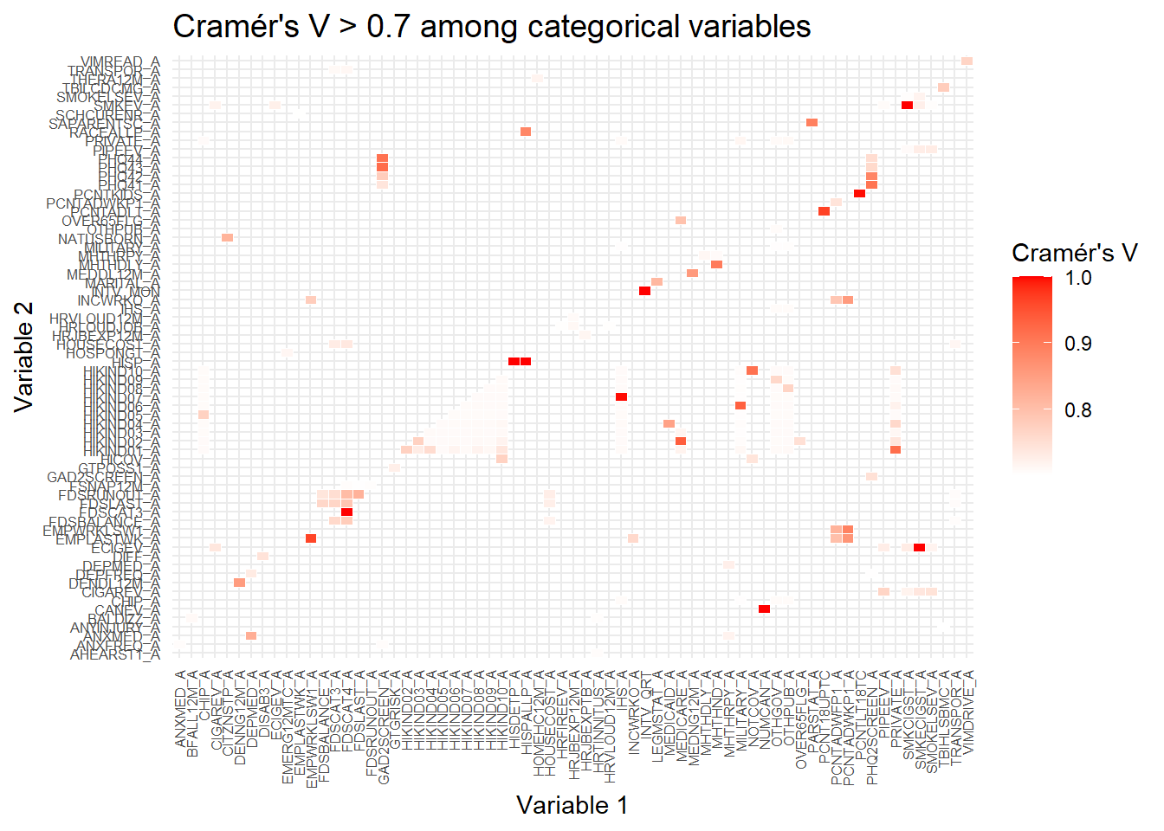
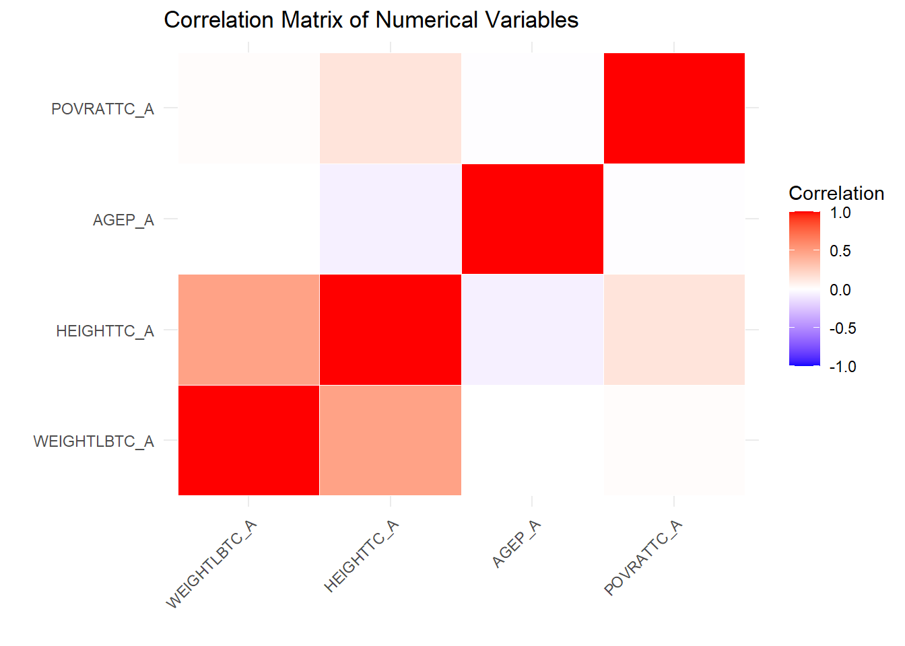
Correlation and Collinearity Analysis

Slide 4
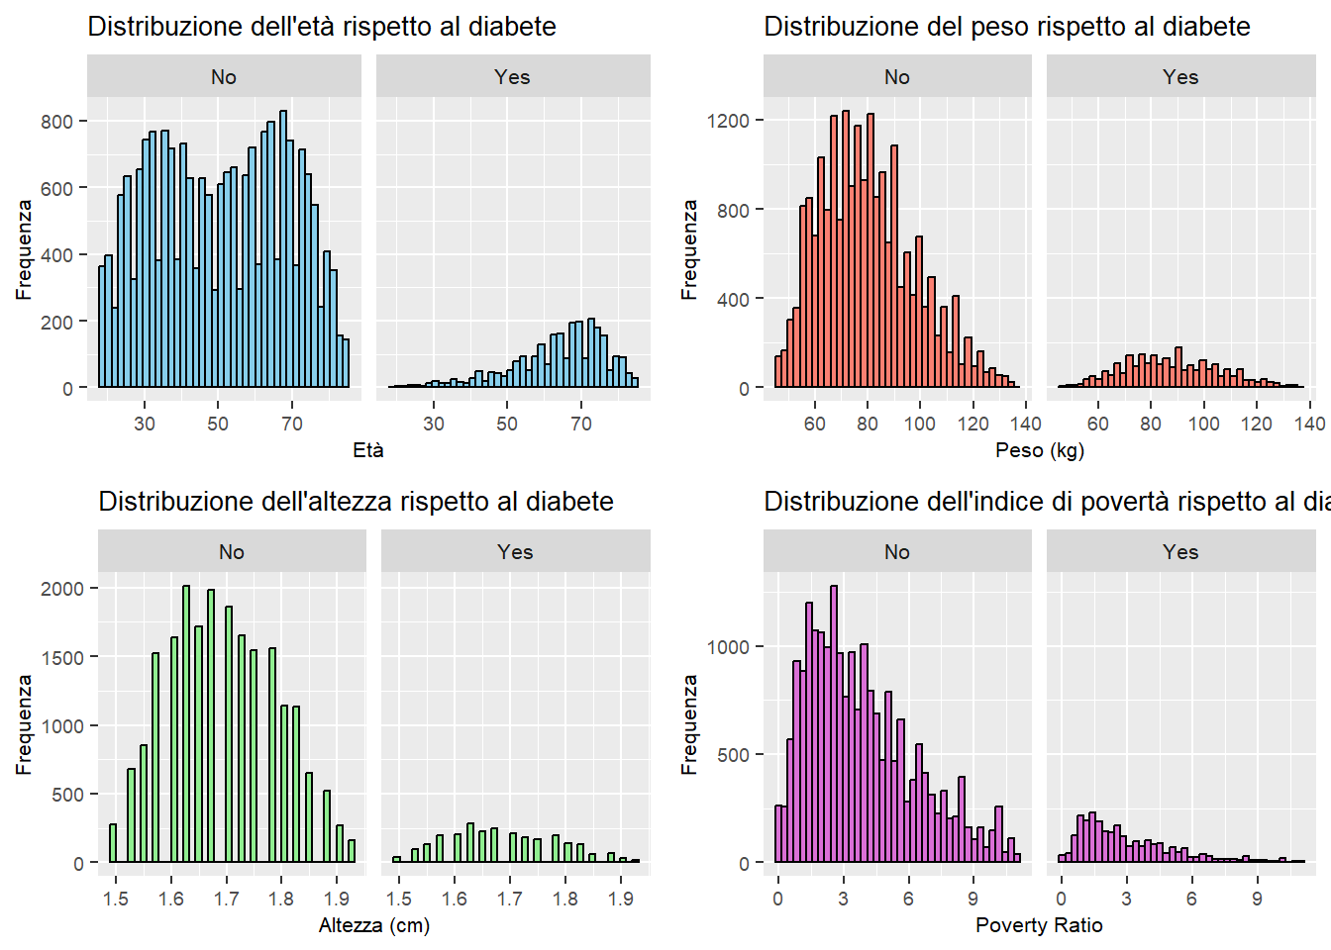
Exploratory Analysis of Numeric Predictors

Slide 5
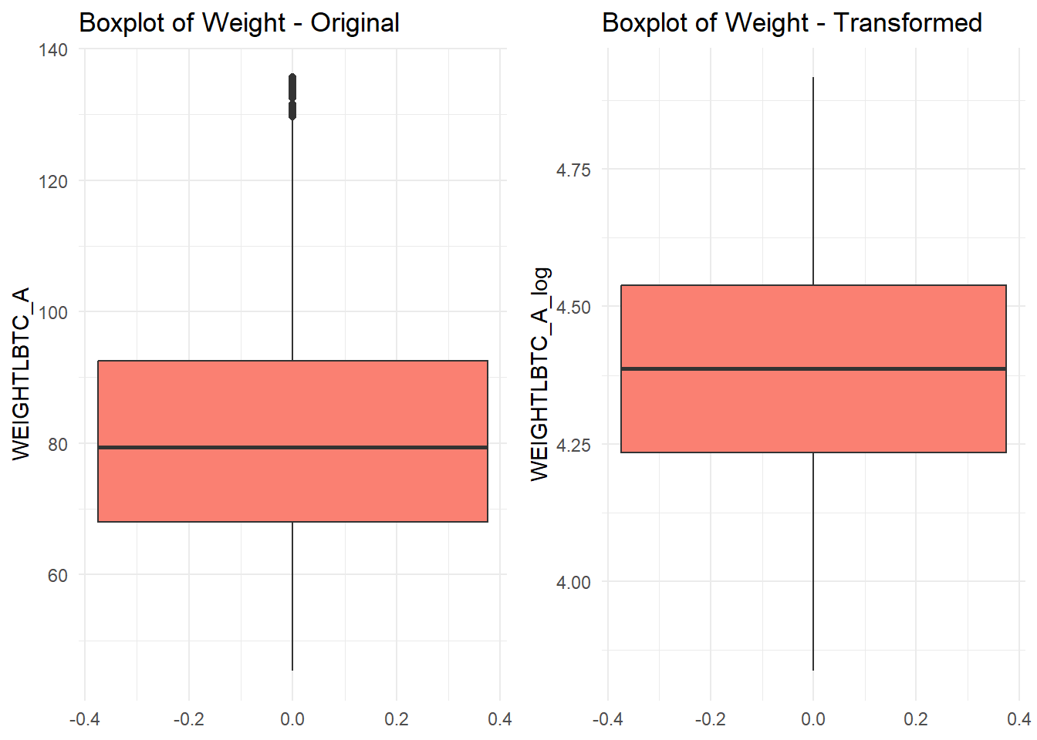
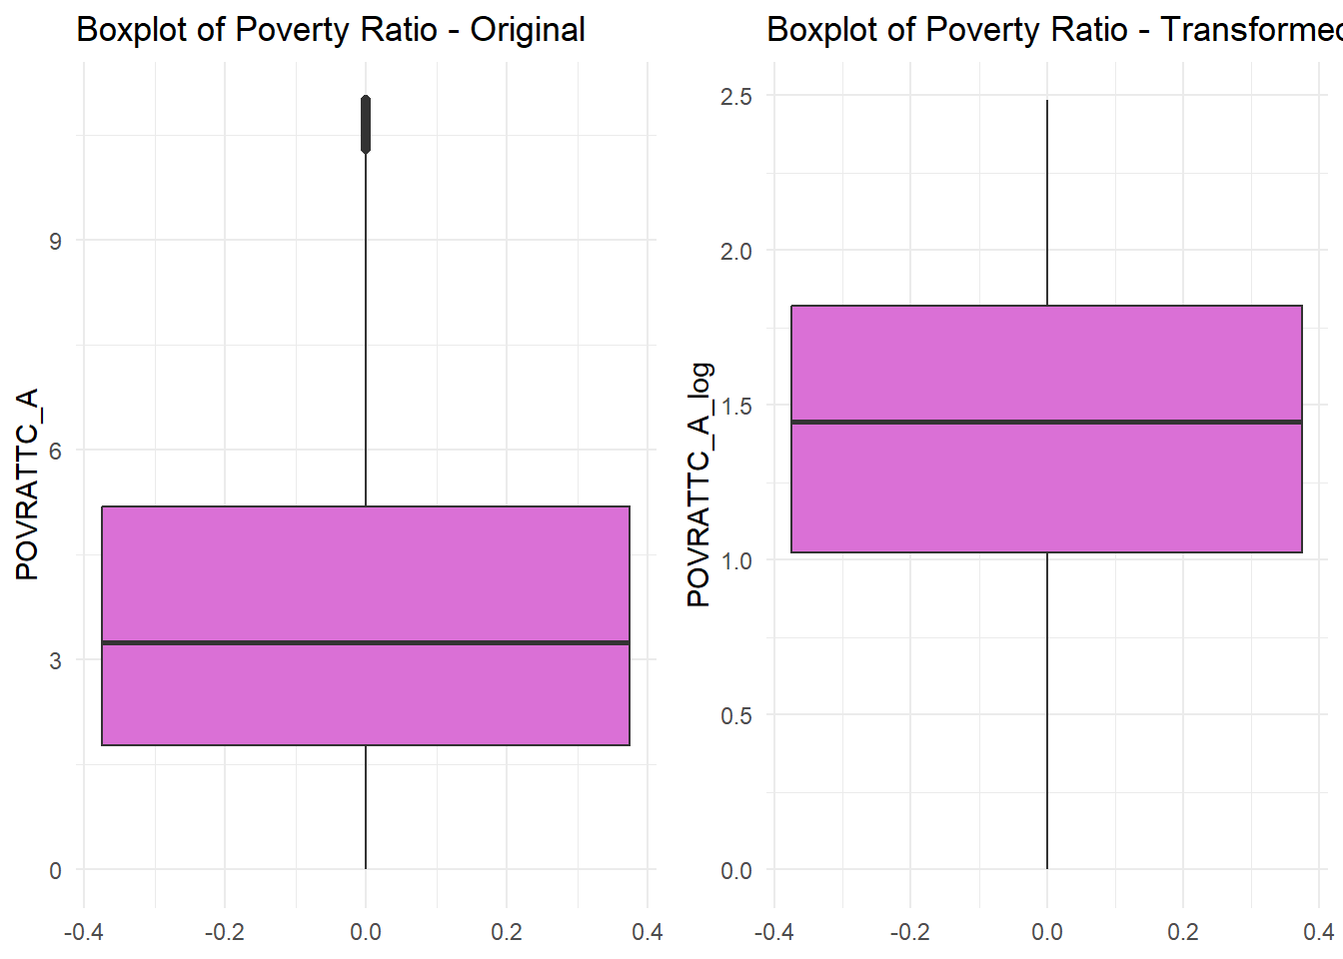
Log Transformation of Numeric Variables

Slide 6
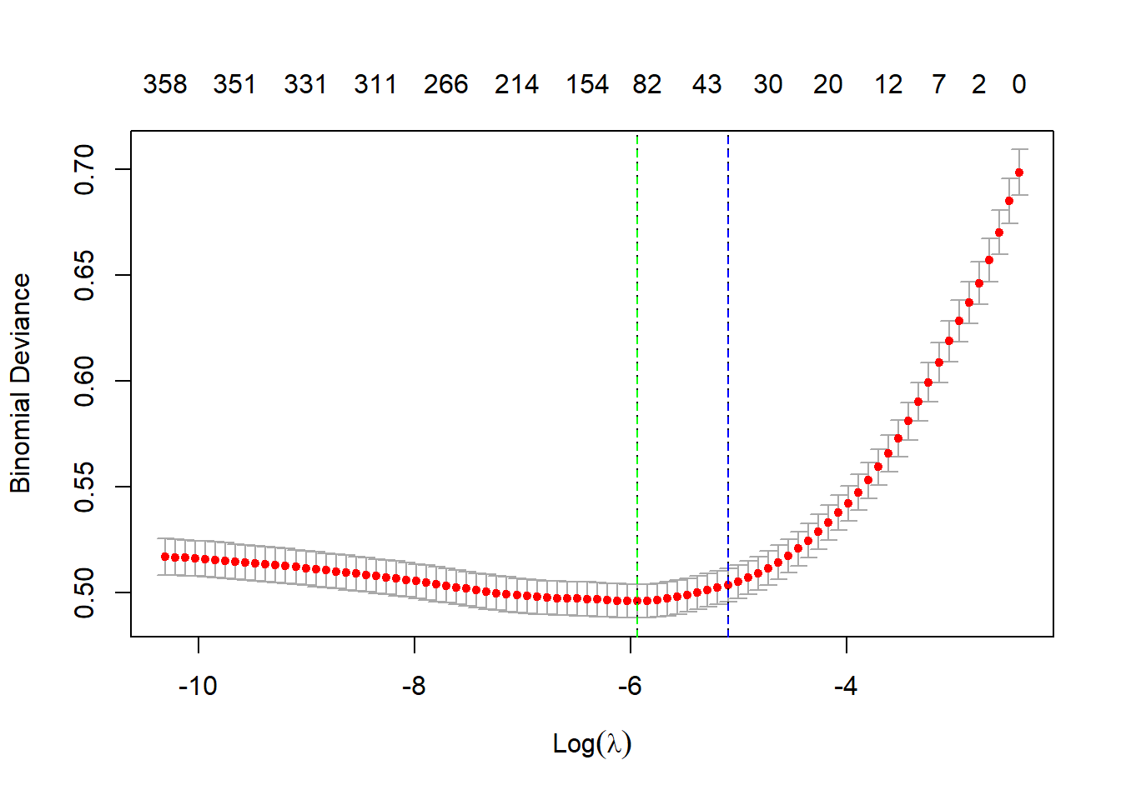

LASSO Model

Slide 7
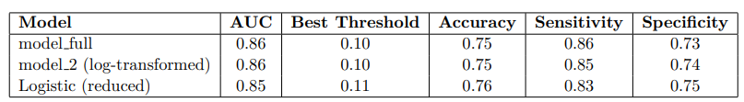
Logistic Regression Modeling
Ethnicity (HISPALLP_A) Ref: Hispanic. Non-Hispanic White and AIAN → Lower risk Non-Hispanic Asian → Higher risk
Age (AGEP_A) Older age → Higher risk
Eye Exam Timing (AVISEXAM_A) Ref: Never. Recent/Unknown exam → Higher risk
No CHD (CHDEV_A2) Ref: Diagnosed CHD. No CHD → Lower risk
No High Cholesterol (CHLEV_A2) Ref: Diagnosed. No cholesterol → Lower risk
No Hypertension (HYPEV_A2) Ref: Diagnosed. No hypertension → Lower risk
Self-Rated Health (PHSTAT_A) Ref: Excellent. Poorer health → Higher risk (dose-response)
Log-Weight (WEIGHTLBTC_A_log) Higher weight → Higher risk
Poverty Ratio (POVRATTC_A_log) Higher income → Lower risk

Slide 8
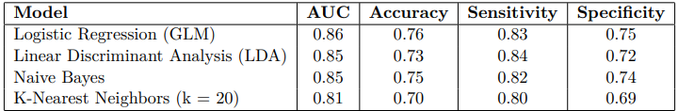
Classification Model Comparison: GLM, LDA, Naive Bayes, and KNN
--- Confusion Matrix: KNN ---
 | No | Yes
No | 6351 | 795
Yes | 0 | 0

Slide 9
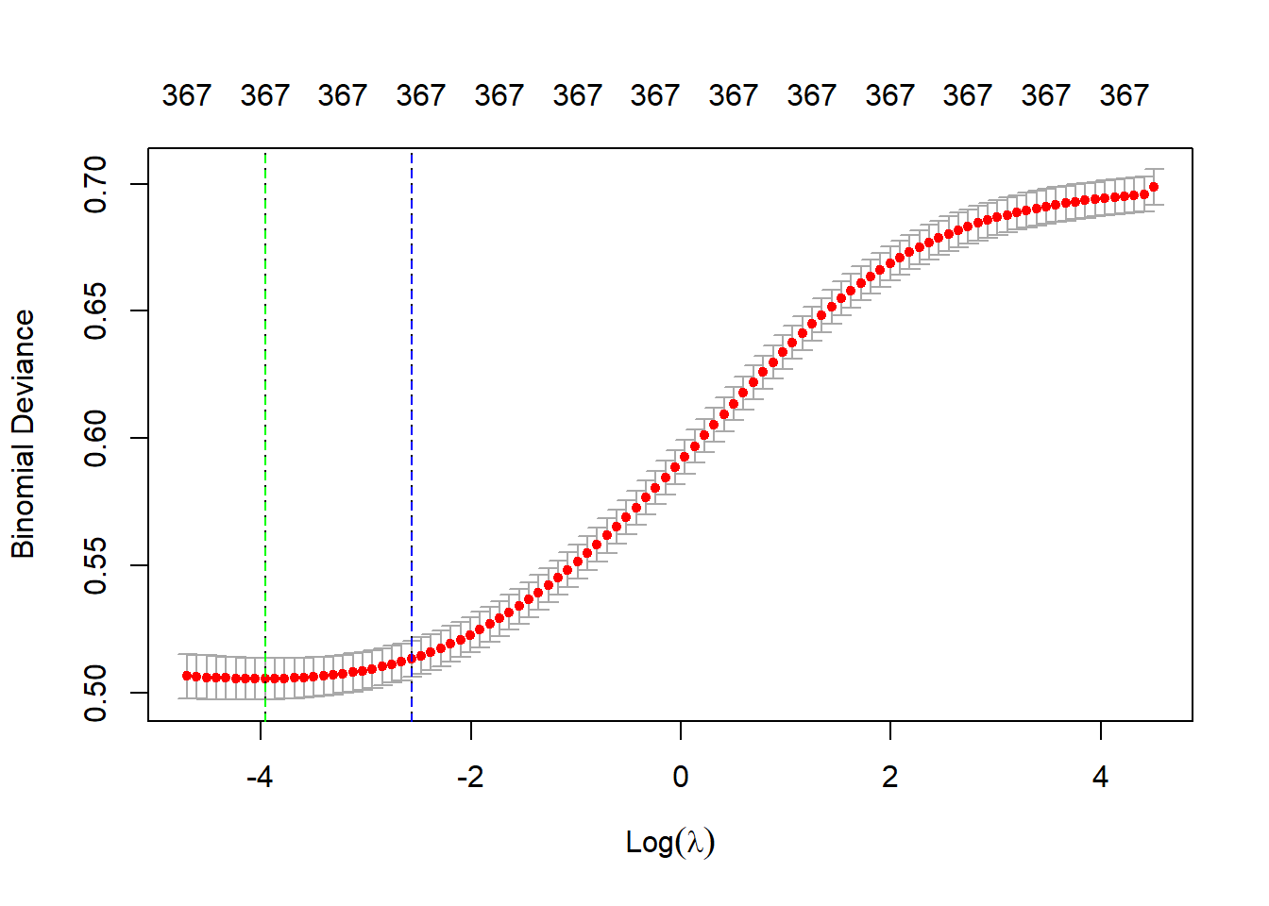

Ridge Model

Slide 10
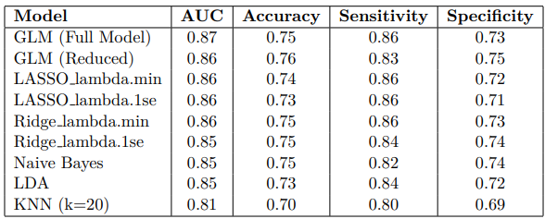
Classification Model Comparison
Best Model: GLM (Reduced)
Worst Model: KNN (k = 20)

